Slide 1

Leadership Development Architecture
Introduction
How will we leverage LDA
Our Leadership Model & Competencies
  Leadership Behavioral Anchors
  LDA toolkit for managers
Communication Plan

Slide 2
Leadership Development Architecture
Leadership Competency Model
3 Learning Journeys
8 Leadership Competencies
Leadership Development Opportunities
Journey 1 G/H
Journey 2 I/J
Journey 3 K/L
Leadership Behavioral Anchors
LDA Toolkit for employees

Slide 3
Leadership Development Architecture
Who is the Leadership Development Architecture (LDA) for?
Those holding a managerial or leadership position.
Pragmatic roadmap providing transparency & guidance on the expected
behaviors of our managers and leaders across the full employee life cycle.
What’s in the LDA and where did it come from?
Focuses on building the Al-Futtaim Leadership Competency framework .
Designed based on a thorough, comprehensive and calibrated analysis of best-in-class leadership attributes within the current business context.
The co-creation of the framework encompassed Leadership representation across all our departments across our divisions.

Slide 4

How will we leverage the LDA?
AT RECRUITMENT
PERFORMANCE MANAGEMENT
DEVELOPMENT PLANNING
LEADERSHIP 360
PROFESSIONAL DEVELOPMENT & GROWTH OPPORTUNITIES
Notes:
This model lays the foundation for several associated tools that will enable us to more effectively select, develop, evaluate, retain, and promote leadership. Leadership competencies will be further associated and integrated as an evaluation and development tool for performance management, 360 feedback, proficiency and leadership development journeys, Promotion and progression, career guidance for employees, recruitment selection and interview process.

Slide 5
Our Leadership Model
Commercial Drive
Goal Driven
Managing Complexity
Customer Centricity
Future Proofing
Change Agile
Activate Innovation
Inspire our People
Grow your Business
At Al-Futtaim, irrespective of whether one directly manages people or not, leaders are expected to:
Grow the Business
Through Inspiring their People
And Activating Innovation
Our Leadership model hinges onto these three key expectations.
Influence and Challenge
Engaging Leadership
Notes:
Traditional leadership competency models are no longer effective in today’s evolving market. To stay competitive, organizations need a new, concise method that employees can easily interpret and apply to their roles. Our condensed, eight-part leadership competency model clearly and simply describes the competencies required to be strong leaders.
Leadership Capability Model
Competency Library to Home Grown Model
Our LDA identifies and describes the 8 Leadership competencies and behaviors considered most important for the Leadership development of employees Bands G and above
Our leadership framework is the category-level architecture, where we have clustered our Leadership competencies into 3 main clusters or expectations (Grow your Business, Activate Innovation & Inspire our people. And out Leadership Behavioral Anchors have been drafted as an outcome of our co-creation workshops with our L&D colleagues.

Slide 6

AL-FUTTAIM LEADERSHIP COMPETENCY FRAMEWORK
Works to delight internal and external customers with exceptional service and products, acting as a trusted advisor
An entrepreneurial mindset; recognize and seize opportunities; take measured risk into account. Focus on initiatives that drive business advancement
Customer centricity
Commercial Drive
Results focused, delivering stretching outcomes both as an individual and through teams, with no fear of failure, showing enthusiasm and self-motivation to perform
Demonstrate an unquestionable willingness to learn everyday, un-learn old approaches, and partner with others to assist them in doing the same
Goal
Driven
We value Respect
Future-proofing
We value Integrity
We value Collaboration
Anticipate and lead change: adapt actions, accordingly, demonstrate tolerance for ambiguity; have a comfort with uncertainty. Shows flexibility in adjusting own views and objectives in order to achieve a shared goal
Change Agile
We value Excellence
Inspire people through a compelling vision fueled by a culture of support, enablement and empathy. Building a safe environment for employees to be at their best, feel included and valued.
Engaging Leadership
Developing talents
Managing complexity
Influence and Challenge
Confident managing the various challenges that our increasingly complex workplace and roles demand: global, digital, competitor, consumer, employees
Create positive momentum by persuading the organization, demonstrating personal courage, and an ability to durably align different opinions

Slide 7
Leadership Behavioral Anchors
Each of the 8 competencies have been expanded into specific Leadership behavioral anchors across 3 proficiency levels
  Level 1 (bands G &H )
  Level 2 (bands I & J )
  Level 3 (Bands K & L)
  This provides transparency of behavioral and capability expectation as employees grow into more senior leadership roles. Enabling employees to take a stronger accountability for their development agenda.
Notes:
What makes an effective Leader?
The banding was co-created with representation from each division.
The initial proposed framework was pressure tested across the divisions, with the objective of
Bringing in diverse perspectives from the reality on the ground within different Divisions and Bands.
Ensuring alignment on the progressive proficiency across levels
Aligning that each proficiency level is cumulative, that means behavioral indicators from lower levels will not be repeated at higher levels although they still apply.

Slide 8
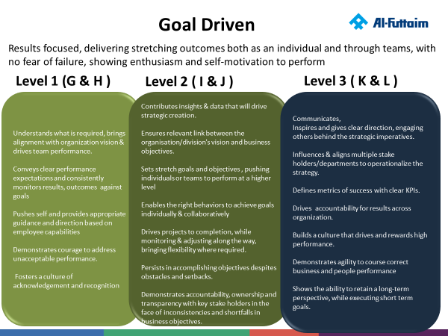
Competency Name
Leadership
Cluster
Activate Innovation
Inspire our People
Grow our Business
Definitions
Proficiency Levels
Leadership
Behavioral Anchors

Slide 9
Leadership Development Architecture : Toolkit
Leadership Competencies
The 8 Leadership Competencies
Leadership behavioral Anchors for Level 1, 2
& 3
Resources
Additional resources for context and best practices
Application suggestions
Development Interventions
Tips for development
Job Assignments for Improvement
Sub-Optimal behaviors
Less skilled behaviors
Overuse of skill
Causes of lower skills

Slide 10
Seq no | Channel | Type | By Whom | Content | Timeline | Target Audience | Status
1 | HR comms | Launch Email | HR Comms | Strengthening the Leadership Foundations with 8 Leadership Competencies | 15 July | Bands G & above | Closed
2 | Intranet | Banner, Carrousel | HR Comms | Leadership Competency themed | 15-20 July | All Employees | Closed
3 | HRBP & L&D awareness session | MS Teams | Group L&D | Leadership Development Architecture | July – Aug | HRBPs & L&D | Closed
4 | Virtual Forums (Co-fac BL,HRBP, L&D) | 6 Divisional education forums, co-facilitated by L&D & Group L&D, supported by HRBP | L&D, HRBP | 60 minutes educational forums | August – September | Bands G & above | Coming Next
5 | Toolkit on iGROW | PDFs, DOCs, presentations | Hosted on Employee I-Grow profile, Intranet | Practical developmental guides with LinkedIn learning courses for each competency | August | Bands G & above
6 | LMS assigned recommended courses | 8, E-learning courses | L&D team | 8, proficiency level E-learning courses to be completed 6 months | August | Bands G & Above
7 | TTT for L&D Leads Application workshops | Group L&D will conduct TTTs for L&D leads to conduct localized application workshops | Group L&D | Application Cohorts | August | Bands G & above
8 | Virtual/F2F L&D lead workshops | Application Workshop | L&D Leads | Application Cohorts | September onwards | Bands G & above
Communication Plan

Slide 11

Grow our Business
Commercial Drive
Goal Driven
Managing Complexity
Activate Innovation
Inspire our People
Grow our Business

Slide 12
Activate Innovation
Inspire our People
Grow our Business
Goal Driven
Results focused, delivering stretching outcomes both as an individual and through teams, with no fear of failure, showing enthusiasm and self-motivation to perform
Level 1 (G & H )
Level 2 ( I & J )
Level 3 ( K & L )
Understands what is required, brings alignment with organization vision & drives team performance
Conveys clear performance expectations and consistently monitors results and outcomes against goals
Pushes self and provides appropriate guidance and direction based on employee capabilities
Demonstrates courage to address unacceptable performance.
Fosters a culture of acknowledgement and recognition
Contributes insights & data that will drive strategic creation
Ensures the relevant link between the division/department's vision and business objectives
Sets stretch goals and objectives , pushing individuals or teams to perform at a higher level
Enables the right behaviors to achieve goals individually & collaboratively
Drives projects to completion, while monitoring & adjusting along the way, bringing flexibility where required.
Persists in accomplishing objectives despites obstacles and setbacks
Demonstrates accountability, ownership and transparency with key stake holders in the face of inconsistencies and shortfalls in business objectives
Communicates, Inspires and gives clear direction, engaging others behind the strategic imperatives
Influences & aligns multiple stake holders/departments to operationalize the strategy
Defines metrics of success with clear KPIs.
Drives accountability for results across organization
Builds a culture that drives and rewards high performance
Demonstrates agility to course correct business and people performance
Shows the ability to retain a long-term perspective, while executing short term goals.

Slide 13








Activate Innovation
Inspire our People
Grow our Business
Goal Driven - Resources
Additional Resources
How can the Goal Driven behaviors help me, and my team re-prioritize, to accelerate business outcomes?
1 | Indeed-10 Tips for Being More Goal-Oriented at Work
2 | KornFerry-Long-Term Purpose, Short-Term Goals
3 | PositivePsychology-What is Goal Setting and How to Do it Well
4 | A Proven Formula For Successfully Reaching Your 2021 Goals (forbes.com)
What new actions and behaviors should I integrate in my self-management and team management approaches?
How can I leverage the behavioral anchors to achieve my goals?
How do I plan to cascade this mindset to my team members?

Slide 14
Activate Innovation
Inspire our People
Grow our Business
Commercial Drive
An entrepreneurial mindset; recognize and seize opportunities; take measured risk into account. Focus on initiatives that drive business advancement
Level 1 (G & H )
Level 2 ( I & J )
Level 3 ( K & L )
Demonstrates a working knowledge of Business & Commercial acumen
Operationalizes and commercializes business processes
Takes responsibility to implement, execute and align to business requirements.
Looks for efficiencies while working on initiatives and opportunities.
Identifies opportunities for improvement, takes measured risks
Demonstrates a working knowledge of managing a P&L and can provide guidance to others undertaking commercial activities.
Demonstrates the ability to operationalize the business strategy optimizing the commercial outcome with optimal outcomes.
To balances calculated risk with commercial outcome.
Considers interdependencies of customer profile, market dynamics (consumer insights, market intelligence, socio economic factors) to drive decisions around business opportunities.
Collaborates with different functions to ensure commercial viability of product/service
Communicates, designs and develops a clear commercial strategy and business model to enable it.
Effectively balances risks and opportunities; and looks for ways to mitigate risks.
Effectively builds and manages relationships with strategic partners.
Demonstrates a Strong understanding of the Business, Market, People and Environment to capture & leverage business opportunities.

Slide 15

Activate Innovation
Inspire our People
Grow our Business
Commercial Drive- Resources
Additional Resources
What are the current business challenges that require prioritization
1 | McKinsey-Commercial Excellence: Your Path to Growth
2 | CIPD-Commercial Drive
3 | https://www.exed.hbs.edu/driving-profitable-growth/
4 | https://psychologyatwork.blog/2020/08/24/developing-a-commercial-mindset/
What actions and behaviors should I be leveraging/developing to be more Commercially focused?
What are the business outcomes that I can positively impact, if I aligned my actions with the commercial drive behaviors?
How can I build this understanding in my team members?

Slide 16
Activate Innovation
Inspire our People
Grow our Business
Managing Complexity
Confident managing the various challenges that our increasingly complex workplace and roles demand: global, digital, competitor, consumer, employees
Level 1 (G & H )
Level 2 ( I & J )
Level 3 ( K & L )
Ability to follow & guide others through processes and SOPs.
Uncovers root causes to difficult problems by asking the right questions.
Shows the ability to seek support and input from the right stake holders to make sense of the situation and move forward.
Demonstrates self management and flexibility, while working with ambiguity.
Finds ways to simplify issues and helps others navigate.
Acquires data and perspectives from multiple and diverse sources (including historical experiences) when solving problems, evaluating the Pros and Cons
Ability to work with complex structures and workplace models
Readily distinguishes, between what's relevant and what's unimportant, to make sense of complex situations.
Demonstrates self resilience and seeks to enable resilience in others.
Ability to break complex challenges into workable chunks.
Demonstrates political savviness.
Understands the impact of complexity on others and actively takes steps to provide support.
Enables the organization to make sense of the complex challenges, analyze perspectives & facilitates the creation of the roadmap/action plans.
Secures alignment of direction, focus and effort whilst navigating complexity.
Demonstrates courage and ability to take calculated risks especially while dealing with ambiguous situations.
Demonstrates political savviness, understands how decisions are made and who influences them, understands and promotes the interests of others to obtain their support

Slide 17
Activate Innovation
Inspire our People
Grow our Business
Managing Complexity Resources
Additional Resources
How can I leverage these behaviours, to address business complexities more effectively?
1 | HBR-Taming Complexity
2 | How to Manage Complexity in Strategy
3 | McKinsey-How do I Manage Complexity in My Organization
4 | Managing complexity with simplicity
What behaviours do I need to strengthen, to get more effective at managing complexity?
Are there areas in my business I can proactively work on to minimize complexity?
How do I plan to support my team members around complexity?

Slide 18

Activates Innovation
Customer Centricity
Future Proofing
Change Agile
Activate Innovation
Inspire our People
Grow our Business

Slide 19
Activate Innovation
Inspire our People
Grow our Business
Customer Centricity
Works to delight internal and external customers with exceptional service and products, acting as a trusted advisor
Level 1 (G & H )
Level 2 ( I & J )
Level 3 ( K & L )
Collates customer insights & feedback and articulates customer expectations clearly to anticipate customer needs .
Provides direction, monitors & provides feedback to ensure team members are providing optimal customer experience.
Establishes and maintains effective customer relationships.
Leverages & engages with key stake holders that can help drive customer requirements.
Collates customer insights & market trends to drive decisions around new business initiatives and offerings
Puts the customer in the heart of design in building & delivering solutions (including services & products)
Takes short-, medium- and long-term perspectives when building relationships with key customers & stake holders.
Maintains a balance between business and customer needs
Creates and drives a culture of customer centricity.
Defines customer success metrics, benchmarking current performance with external market & Global Customer Trends
Drives strategic initiatives, that are rooted in customer data analytics, socioeconomic understanding & current market trends.
Cultivates enriching diplomatic relationships

Slide 20
Activate Innovation
Inspire our People
Grow our Business
Customer Centricity - Resources
Additional Resources
How am I planning to leverage the Leadership Behaviors to be more customer centric?
1 | Hays-improve-customer-centricity-leadership-team
2 | KPMG-Customer First
3 | Break the NPS Plateau: Create a Culture of Customer Experience (gallup.com)
4 | Prediction: The future of customer experience | McKinsey
How can I reset my actions using the Leadership behaviors to amplify Customer Centricity?
How am I planning to create a better customer impact using the Leadership Behaviors?
How would I plan to enhance this mindset with my team members?

Slide 21
Activate Innovation
Inspire our People
Grow our Business
Future Proofing
Demonstrate an unquestionable willingness to learn everyday, un-learn old approaches, and partner with others to assist them in doing the same
Level 1 (G & H )
Level 2 ( I & J )
Level 3 ( K & L )
Shows curiosity to stay up-to date with relevant knowledge and skills for the future
Encourages curiosity within team members to reinforce learning within the team
Enables team members with the right opportunities and resources to learn on their job
Is able to grasp new & relevant technologies, processes and learnings
Anticipates future trends and implications accurately
Defines key skills, tools and resources required for future success
Demonstrates agility to learn new approaches
Has a mindset to develop teams for future readiness developing internal capability and skills required to be successful in the future.
Applies technology & innovative approaches to achieve better results
Sees the bigger picture, constantly imagining future scenarios and creating strategies to sustain competitive advantages.
Builds a future focused talent & succession plan that optimizes the talent pipeline.
Formulates a road map, outlining the skills/roles that are required for future success, and how to optimize the current workforce to achieve the vision.
Demonstrates authenticity to admit shortfalls & allows the space to leverage team expertise

Slide 22

Activate Innovation
Inspire our People
Grow our Business
Future Proofing - Resources
Additional Resources
Am I using the Leadership Behaviors to get my business future proofed?
1 | Forbes-How To Future-Proof Your Organization
2 | MichaelPage-Future of Leadership
3 | McKinsey-Getting Ready for the Future of Work
4 | The Future of Sales and Marketing is here
How can I reset my actions using the Leadership behaviors to be future centric?
How can my business outcomes be impacted through my future proofing plans? Are my plans realistic and viable?
How would I plan to future proof my team members?

Slide 23
Activate Innovation
Inspire our People
Grow our Business
Change Agile
Anticipate and lead change: adapt actions, accordingly, demonstrate tolerance for ambiguity; has comfort with uncertainty. Shows flexibility in adjusting own views and objectives in order to achieve a shared goal
Level 1 (G & H )
Level 2 ( I & J )
Level 3 ( K & L )
Demonstrates emotional and social awareness, managing self and enabling the team during change
Demonstrates adaptability and resilience to evolving changing situations
Executes required changes due to evolving business requirements
Understands the need for change and enables plans to ensure execution
Acts as an advocate & role model for change
Leverages social and emotional intelligence to support teammates and colleagues through change
Identifies & communicates wins, milestones and achievements
Effectively integrates change into in the processes & systems to sustain the change.
Demonstrates an open mind and flexibility to course adjust and the business needs change.
Calibrates and applies emerging trends to proactively anticipate change, while seeking to address future desired state.
Sets the burning platform for change and drives from the front.
Thinks holistic about change
Creates a space for experimenting, failing fast, to be able to recover and reset.

Slide 24

Activate Innovation
Inspire our People
Grow our Business
Change Agile - Resources
Additional Resources
How can I use the Change Agile Leadership Behaviors to drive the business agenda?
1 | McKinsey-Leading Agile Transformation-The new capabilities leaders need to build 21st-century organizations
2 | BCG-Do You Have the Courage to Be an Agile Leader?
3 | The Leadership Agility Factor
4 | How to build Change capability with structure and intent?
What are those workplace actions that I can reset with the help of the change agile behaviors?
How can I accelerate some of my business outcomes by being more change agile?
What could you be doing more of to support your team be more change agile?

Slide 25

Inspire our People
Engaging Leadership
Influence and Challenge
Activate Innovation
Inspire our People
Grow our Business

Slide 26
Activate Innovation
Inspire our People
Grow our Business
Engaging Leadership
Inspire people through a compelling vision fueled by a culture of support, enablement and empathy. Building a safe environment for employees to be at their best, feel included and valued.
Level 1 (G & H )
Level 2 ( I & J )
Level 3 ( K & L )
Fosters a sense of team spirit, alignment and purpose
Treats people fairly and considerately at work
Engages and enables, team members to grow
Adapts behavioral style to different personality styles.
Listens & empathizes before responding to situations.
Demonstrates understanding of their own impact on others
Leverages emotional intelligence, while building trust and alignment with team members, stakeholder& customers
Empowers others & shows a genuine interest in seeing the team members grow and flourish
Leads with empathy & consideration during difficult situations, while advocating for healthy conflict
Promotes a collaborative work environment
Facilitates the connection between people's motivators and organizational goals
Recognizes & encourages contributions of others.
Is able to bring learning out of all situations, including mistakes and failure
Passionately communicates the vision and gains alignment and acceptance.
Creates a compelling environment that enables managers and leaders to support others to be their best at work.
Inspires & role models engagement inclusion and empathy.
Drives an open communication 'speak-up' culture.
Champions a learning culture, where reflection on wins and misses are capitalized on, in all that we do.
Role models and demands trustworthy behavior from others.

Slide 27
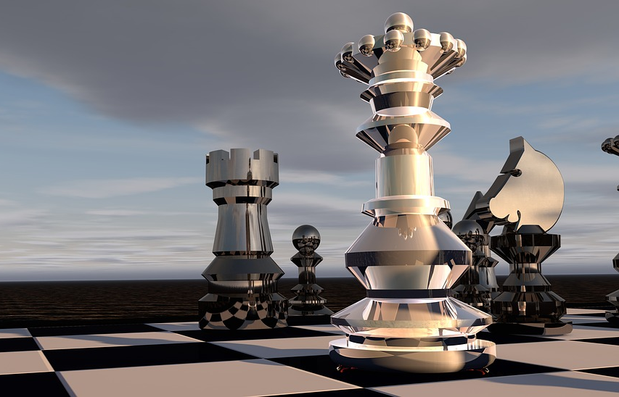
Activate Innovation
Inspire our People
Grow our Business
Engaging Leadership - Resources
Additional Resources
In which situations should I be leveraging the Engaging Leadership style to achieve a better outcome?
1 | Adapt your leadership style to your situation
2 | 15 Ways To Promote Psychological Safety At Work (forbes.com)
3 | How the most successful leaders will thrive in an exponential world
What actions and behaviors can I focus on strengthening in my working style to be more Engaging?
What impact (on my team/ my customer base/ the business) am I hoping for, if I lead with a more Engaging style?
What’s the one thing you can do differently today, to be a more engaging leader to your team?

Slide 28
Activate Innovation
Inspire our People
Grow our Business
Influence and Challenge
Create positive momentum by persuading the organization, demonstrating personal courage, and an ability to durably align different opinions
Level 1 (G & H )
Level 2 ( I & J )
Level 3 ( K & L )
Articulates opinions and is willing to question the status quo in a compelling manner that gains buy in from stakeholders.
Demonstrates clear self awareness of their impact while communicating
Develops credibility with peers, leaders and juniors.
Demonstrates gravitas, emotional intelligence & credibility to impact decisions.
Balances and effectively aligns the interests of multiple stakeholders, ensuring that the right projects are given priority and focus.
Influences other to take action
Negotiates skillfully in tough situations, wins concessions without damaging relationships.
Intentionally develops and leverages own internal and external network.
Demonstrates political savviness while dealing and considering interests of different stake holders.
Maintains frequent interactions with a broad stakeholder network and takes a proactive approach to shape and influence stakeholder expectations, both upwards and downwards.
Ability to bring consensus amongst teams & departments to move the agenda forward.

Slide 29
Activate Innovation
Inspire our People
Grow our Business
Influence and Challenge - Resources
Additional Resources
What behaviors can I leverage in my own management style that can inspire and influence people while tackling business challenges?
1 | The 5 key traits of persuasive leaders
2 | How to develop and master executive presence?
3 | Mentorship as a tool to inspire the next generation
4 | How To Establish Credibility: 4 Strategies Leaders Always Use (forbes.com)
What actions and behaviors should I embed in my daily operating style to support my ability to inspire and influence others?
How intentional am I being in building my network for today, tomorrow and the day after tomorrow?
What else should I know about my team members, to influence and inspire them further.

